Slide 1
NSTX-U High-k Scattering receiver optical calculation and calibration
Xinhang Xu
7/25/2024

Slide 2
introduction
3D structure of Receive Optical
Sketch of the NSTX-U High-k Scattering Receiver Geometry
Receiver optical calibration
Error analysis
Software development
Summary

Slide 3
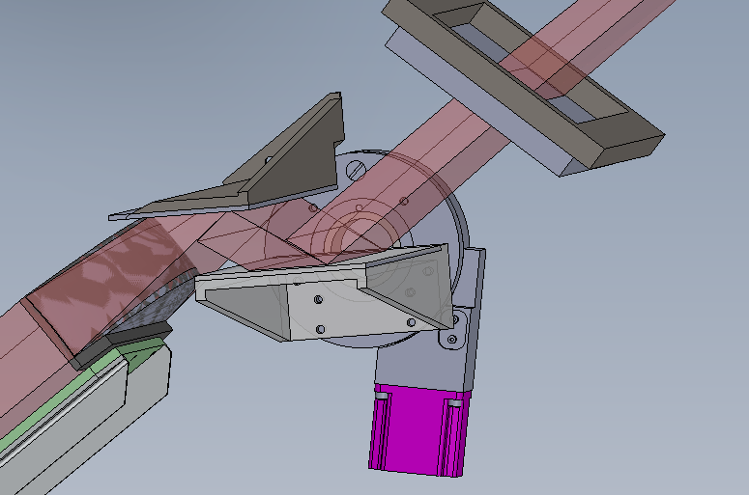
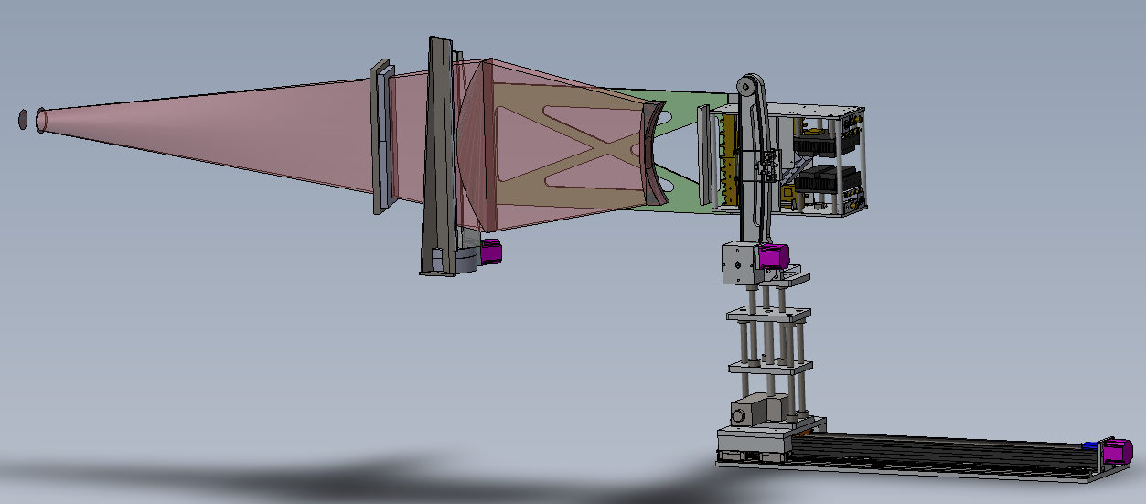
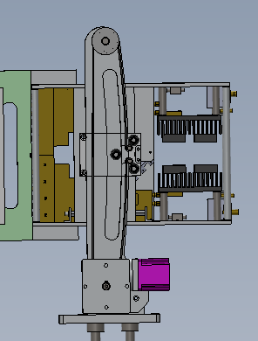
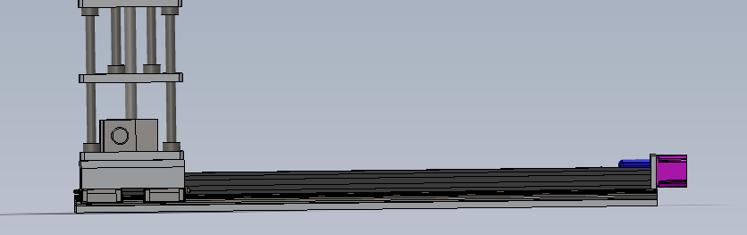
3D structure of Receive Optical
Toroidal antenna Motor
Window
Focus point
R antenna Motor
Z antenna Motor
Tilt antenna Motor

Slide 4
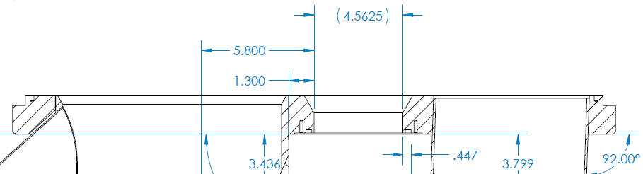
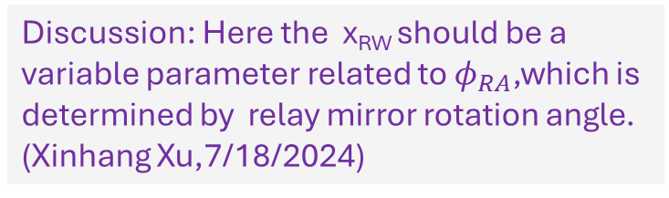
NSTX-U High-k Scattering Receiver Geometry(By Calvin and Xianzi)
Torus Center
ψ_{RA}
x_{RW} = x-axis offset of receiver beam on window (nominally half of window width or 58 mm)
φ_{RA} = horizontal tilt of receiver array and optics (between 11.39 and 15.39°)
z_{IR} = distance from window to interaction region (between 200 and 850 mm)
z_{IR} = distance from window to interaction region (measured along plasma midplane)
R_{RW} = major radius of vacuum window (fixed)
R_{IR} = major radius of interaction region
ψ_{RA} = toroidal tilt angle of interaction region (w.r.t. plane of vacuum window)
ψ_{R} = toroidal tilt angle between receiver beam and Radius vector (from torus center)
R_{IR}
Toroidal tilt angle due to x-axis offset: ψ_{X} = tan^{‒1}(x_{RW}/R_{RW})
φ_{RA} = φ_{RA} + ψ_{X}
R_{RW}² = R_{RW}² + x_{RW}²
R_{IR}² = R_{RW}² + z_{IR}² – 2R_{RW}·z_{IR}·cos(φ_{RA})
ψ_{RA} = ψ_{X} + sin^{‒1}((z_{IR}/R_{IR})·sin(φ_{RA}))
ψ_{R} = ψ_{RA} + φ_{RA}
ψ_{X}
ψ_{R}
Interaction Region (IR)
R_{RW}
R_{RW}
z_{IR}
Discussion: Here the x_{RW} should be a variable parameter related to $φ_{RA}$,which is determined by relay mirror rotation angle. (Xinhang Xu,7/18/2024)
φ_{RA}
φ_{RA}
Bay L Port Cover
x_{RW}
Window

Slide 5
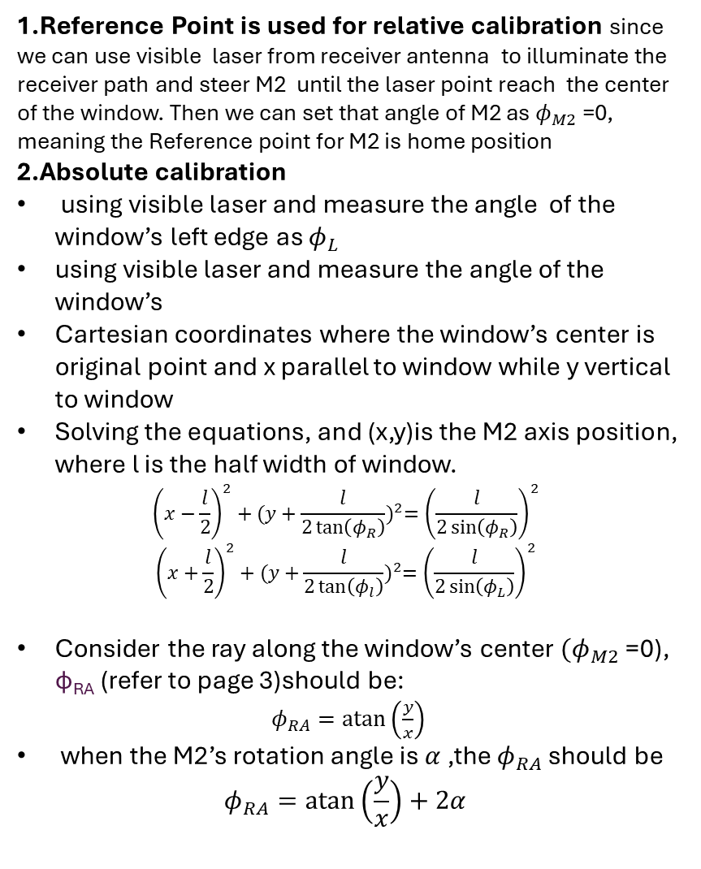


High-k Receiver optical Calibration: find the position of M2 axis which determine the angle of $φ_{RA}$
1.Reference Point is used for relative calibration since we can use visible laser from receiver antenna to illuminate the receiver path and steer M2 until the laser point reach the center of the window. Then we can set that angle of M2 as $φ_{M2}$ =0, meaning the Reference point for M2 is home position
2.Absolute calibration
using visible laser and measure the angle of the window’s left edge as $φ_{L}$
using visible laser and measure the angle of the window’s
Cartesian coordinates where the window’s center is original point and x parallel to window while y vertical to window
Solving the equations, and (x,y)is the M2 axis position, where l is the half width of window.
$${\left(x−\frac{l}{2}\right)}^{2}+{(y+\frac{l}{2\tan\left(φ_{R}\right)})}^{2}={\left(\frac{l}{2\sin\left(φ_{R}\right)}\right)}^{2}$$
$${\left(x+\frac{l}{2}\right)}^{2}+{(y+\frac{l}{2\tan\left(φ_{l}\right)})}^{2}={\left(\frac{l}{2\sin\left(φ_{L}\right)}\right)}^{2}$$
Consider the ray along the window’s center $(φ_{M2}$ =0), φ_{RA} (refer to page 3)should be:
$φ_{RA}=\operatorname{atan}\left(\frac{y}{x}\right)$
when the M2’s rotation angle is $α$ ,the $φ_{RA}$ should be
$$φ_{RA}=\operatorname{atan}\left(\frac{y}{x}\right)+2α$$
Torus Center
Reference Point
Bay L Port Cover
φ_{RA}
$$φ_{R}$$
$$φ_{L}$$
M1
M2
Distance from M2 axis to center of window :153.9mm
Right max angle of the edge:12.739degree
Left max angle of the edge:19.764degree
L_{OFF-AXIS}=131.3mm

Slide 6
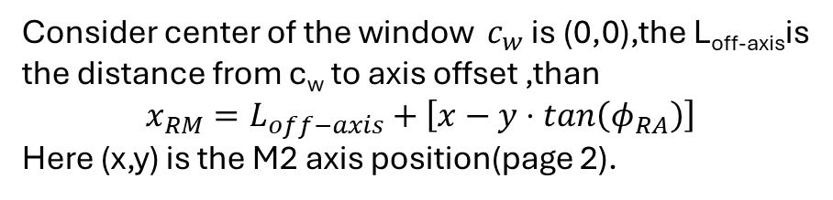

High-k Receiver optical Calibration: Calculate X_{RA}
φ_{RA}
Consider center of the window $c_{w}$ is (0,0),the L_{off-axis}is the distance from c_{w} to axis offset ,than
$$x_{RM}=L_{off−axis}+\left[x−y⋅tan\left(φ_{RA}\right)\right]$$
Here (x,y) is the M2 axis position(page 2).
x_{RW}
c_{w}(0,0)
$$L_{off−axis}$$
Window
(x,y)
M2

Slide 7



Error analysis
Given $φ_{L}={25}^{o},φ_{R}={19}^{o}$,L=70mm
x₀=-58.65mm, y₀=-154.42mm,$φ_{RA0}={20.8}^{o}$
$$abs(φ_{RA}−φ_{RA0})(deg)$$
1.1º error shift correspond to 4mm distance shift on the window, given the laser beam size is about 4mm, the error range could be ideally contained in 1º
2.This method only can make sure the incident angle error in 6º

Slide 8
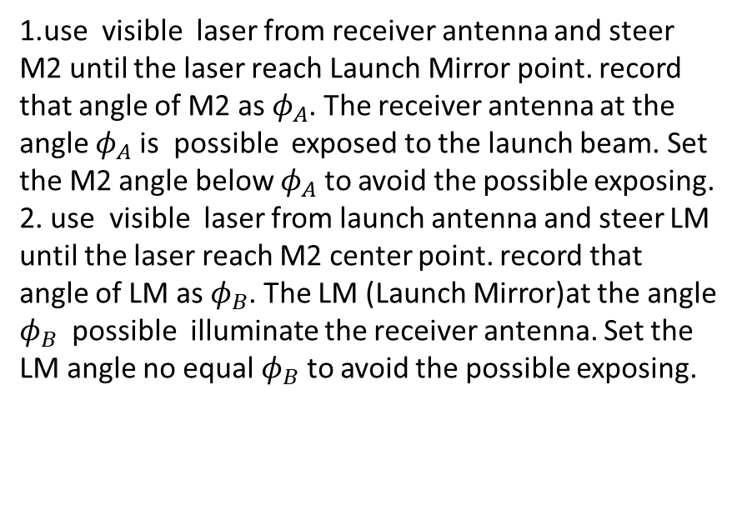
Way to Avoid exposing any of the receiver channels to the direct launch beam
Bay G Launch Mirror
(LM)
1.use visible laser from receiver antenna and steer M2 until the laser reach Launch Mirror point. record that angle of M2 as $φ_{A}$. The receiver antenna at the angle $φ_{A}$ is possible exposed to the launch beam. Set the M2 angle below $φ_{A}$ to avoid the possible exposing.
2. use visible laser from launch antenna and steer LM until the laser reach M2 center point. record that angle of LM as $φ_{B}$. The LM (Launch Mirror)at the angle $φ_{B}$ possible illuminate the receiver antenna. Set the LM angle no equal $φ_{B}$ to avoid the possible exposing.
Reference Point
Interaction Region (IR)
Bay L Port Cover
M1
M2

Slide 9
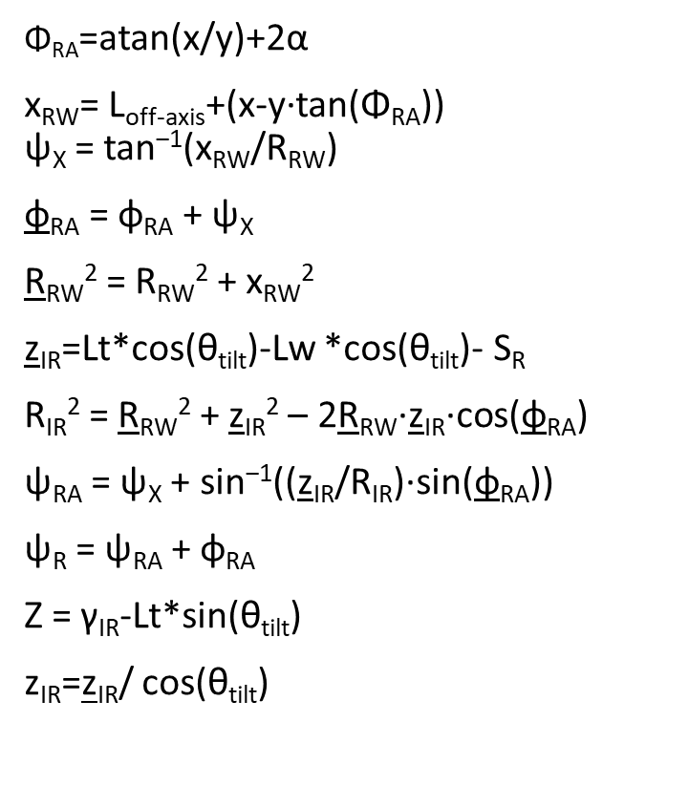
Input parameters:
S_{R} = receiver optical radical distance
θ_{tilt} = poloidal tilt angle of receiver optical
α = M2(mirror 2) rotation angle，α∈(-9º,6º)
γ_{IR} = IR height above midplane
Constant parameters :
L_{off-axis} = x-axis offset of receiver beam on window center (131.3mm).
R_{RW} = major radius of vacuum window (fixed)1873.5mm.
Lt = optical total length from receiver antenna axis to focus point(2088mm).
Lw =length from receiver antenna axis to window1 (1132mm) when SR=0.
x ,y = M2(mirror 2) position(M2 center to Window center :154mm,angle:13.76º)
Depend parameters:
R_{IR} = major radius of interaction region
ψ_{RA} = toroidal tilt angle of interaction region (w.r.t. plane of vacuum window)
ψ_{R} = toroidal tilt angle between receiver beam and Radius vector (from torus center)
φ_{RA} = horizontal tilt of receiver array and optics (between 11.39 and 15.39°)
z_{IR} = distance from window to interaction region (between 200 and 850 mm)
z_{IR} = distance from window to interaction region (measured along plasma midplane)
Z = antenna height above midplane
Torus Center
$\text{Φ}\text{RA}$=atan(x/y)+2α
x_{RW}= L_{off-axis}+(x-y·tan(Φ_{RA})) ψ_{X} = tan^{‒1}(x_{RW}/R_{RW})
φ_{RA} = φ_{RA} + ψ_{X}
R_{RW}² = R_{RW}² + x_{RW}²
z_{IR}=Lt*cos(θ_{tilt})-Lw *cos(θ_{tilt})- S_{R}
R_{IR}² = R_{RW}² + z_{IR}² – 2R_{RW}·z_{IR}·cos(φ_{RA})
ψ_{RA} = ψ_{X} + sin^{‒1}((z_{IR}/R_{IR})·sin(φ_{RA}))
ψ_{R} = ψ_{RA} + φ_{RA}
Z = γ_{IR}-Lt*sin(θ_{tilt})
z_{IR}=z_{IR}/ cos(θ_{tilt})
ψ_{RA}
R_{IR}
ψ_{X}
ψ_{R}
R_{RW}
Interaction Region (IR)
R_{RW}
z_{IR}
φ_{RA}
φ_{RA}
x_{RW}
Window

Slide 10
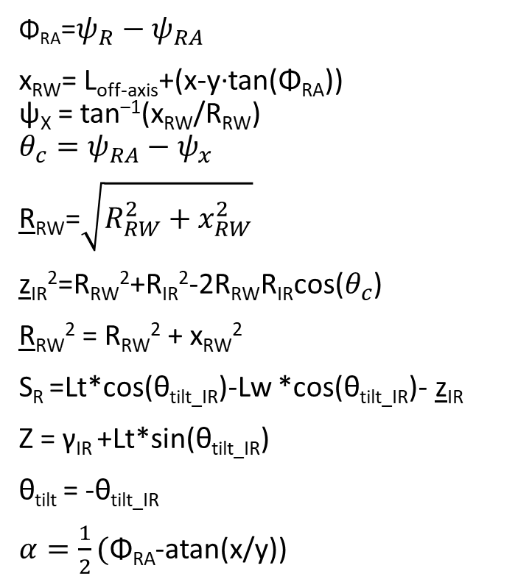
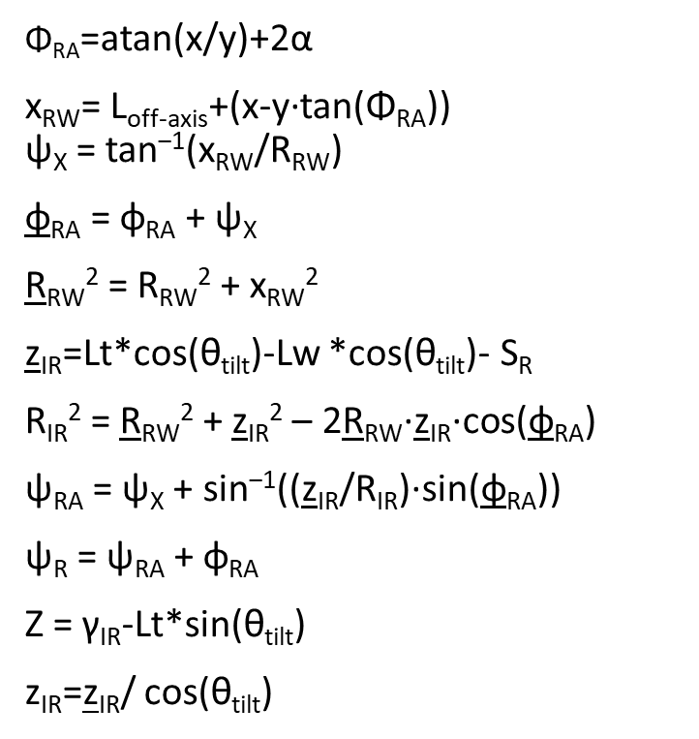
From Interaction region to antenna setup
Torus Center
ψ_{RA}
$\text{Φ}\text{RA}$=atan(x/y)+2α
x_{RW}= L_{off-axis}+(x-y·tan(Φ_{RA})) ψ_{X} = tan^{‒1}(x_{RW}/R_{RW})
φ_{RA} = φ_{RA} + ψ_{X}
R_{RW}² = R_{RW}² + x_{RW}²
z_{IR}=Lt*cos(θ_{tilt})-Lw *cos(θ_{tilt})- S_{R}
R_{IR}² = R_{RW}² + z_{IR}² – 2R_{RW}·z_{IR}·cos(φ_{RA})
ψ_{RA} = ψ_{X} + sin^{‒1}((z_{IR}/R_{IR})·sin(φ_{RA}))
ψ_{R} = ψ_{RA} + φ_{RA}
Z = γ_{IR}-Lt*sin(θ_{tilt})
z_{IR}=z_{IR}/ cos(θ_{tilt})
$\text{Φ}\text{RA}$=${ψ_{R}−ψ}_{RA}$
x_{RW}= L_{off-axis}+(x-y·tan(Φ_{RA})) ψ_{X} = tan^{‒1}(x_{RW}/R_{RW})
$$θ_{c}=ψ_{RA}−ψ_{x}$$
R_{RW}=$\sqrt{R_{RW}^{2}+x_{RW}^{2}}$
z_{IR}²=R_{RW}²+R_{IR}²-2R_{RW}R_{IR}cos($θ_{c}$)
R_{RW}² = R_{RW}² + x_{RW}²
S_{R} =Lt*cos(θ_{tilt_IR})-Lw *cos(θ_{tilt_IR})- z_{IR}
Z = γ_{IR} +Lt*sin(θ_{tilt_IR})
θ_{tilt} = -θ_{tilt_IR}
$α=\frac{1}{2}(\text{Φ}\text{RA}$-atan(x/y))
R_{IR}
ψ_{X}
ψ_{R}
R_{RW}
Interaction Region (IR)
R_{RW}
z_{IR}
φ_{RA}
φ_{RA}
x_{RW}
Window

Slide 11
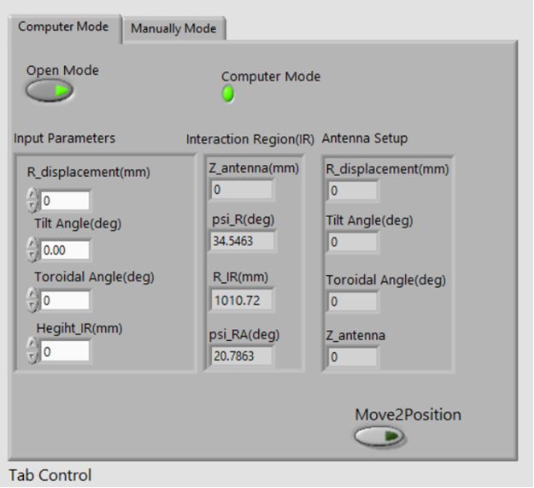
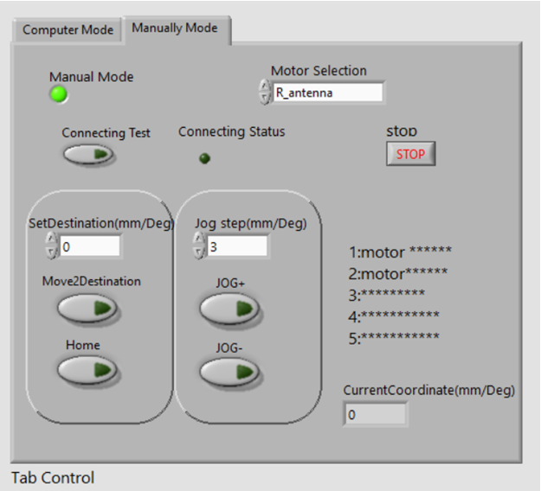
Control software

Slide 12
Summary :
1.Analysis the method for absolute calibration of receiver angle, which ensure the error range in 6⁰ .
2.Method to check the direct illumination angle between launch mirror and receiver mirror to avoid exposing
any of the receiver channels to the launch beam.
3. Develop software of receiver optical system for calculating the Interaction region and system position
control

Slide 13
appendix

Slide 14


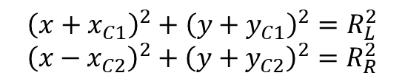
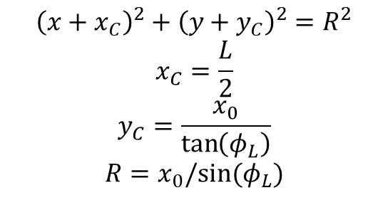

Geometrical relation between angle and mirror axis
Left edge(-L,0)
Window center(0,0)
Right edge(L,0)
$$φ_{L}$$
$${\left(x+x_{C1}\right)}^{2}+{\left(y+y_{C1}\right)}^{2}=R_{L}^{2}$$
$${\left(x−x_{C2}\right)}^{2}+{\left(y+y_{C2}\right)}^{2}=R_{R}^{2}$$
$$φ_{L}$$
$$φ_{R}$$
$${\left(x+x_{C}\right)}^{2}+{\left(y+y_{C}\right)}^{2}=R^{2}$$
$$x_{C}=\frac{L}{2}$$
$$y_{C}=\frac{x_{0}}{\tan\left(φ_{L}\right)}$$
$$R=x_{0}/sin⁡(φ_{L})$$
Mirror axis(x₀,y₀)

Slide 15
Background Information Slides on scattering wavenumber and Pitch Angle Effects
By Calvin

Slide 16
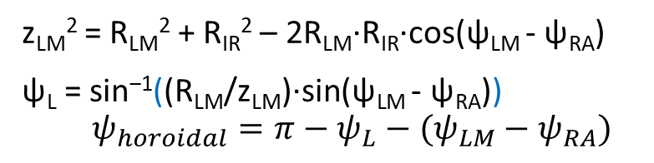
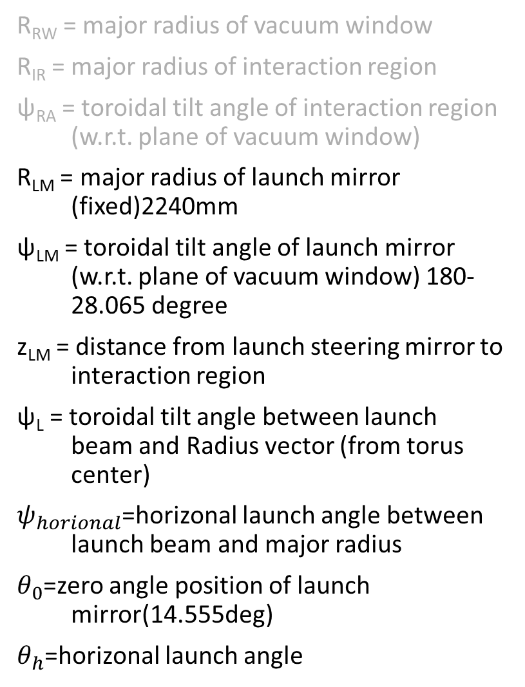



NSTX-U High-k Scattering Launch Geometry
Bay G Launch Mirror
R_{RW} = major radius of vacuum window
R_{IR} = major radius of interaction region
ψ_{RA} = toroidal tilt angle of interaction region (w.r.t. plane of vacuum window)
R_{LM} = major radius of launch mirror (fixed)2240mm
ψ_{LM} = toroidal tilt angle of launch mirror (w.r.t. plane of vacuum window) 180-28.065 degree
z_{LM} = distance from launch steering mirror to interaction region
ψ_{L} = toroidal tilt angle between launch beam and Radius vector (from torus center)
$ψ_{horional}$=horizonal launch angle between launch beam and major radius
$θ_{0}$=zero angle position of launch mirror(14.555deg)
$θ_{h}$=horizonal launch angle
$$ψ_{horoidal}$$
R_{LM}
$$θ_{0}$$
$$θ_{h}$$
Torus Center
z_{LM}
ψ_{LM}
ψ_{RA}
ψ_{L}
R_{IR}
Interaction Region (IR)
R_{RW}
z_{LM}² = R_{LM}² + R_{IR}² – 2R_{LM}·R_{IR}·cos(ψ_{LM} - ψ_{RA})
ψ_{L} = sin^{‒1}((R_{LM}/z_{LM})·sin(ψ_{LM} - ψ_{RA}))
$$ψ_{horoidal}=π−ψ_{L}−(ψ_{LM}−ψ_{RA})$$
Window

Slide 17
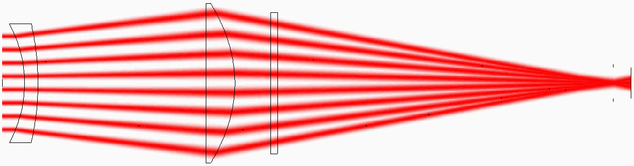
NSTX-U High-k Scattering Wavenumber Calculations (Ignore Magnetic Pitch Factor)
Launch Beam
If the launch and receive beams are toroidally aligned, then the radial component is zero. A slight toroidal tilt is, however, required to minimize unscattered power illuminating the sensitive receiver mixers.
Calculate the amount of radial wavenumber required to toroidally steer the scattered beams.
Then calculate the k_{θ} components due to the vertical tilt angle θ of a given channel.
ψ_{L}
Interaction Region (IR)
k_{R} = k₀·(cosψ_{R} – cosψ_{L})
Radial Vector
k_{θ} = k₀·sinθ
ψ_{R}
Receive Beam
Poloidal View of High-k Receiver
Window

Slide 18
Effects of Magnetic Pitch Angle
The magnetic pitch angle α is the angle between the total magnetic field B_{TOT} and the toroidal magnetic field B_{TOR} due to the presence of a non-zero poloidal magnetic field B_{θ}.
The magnetic pitch angle causes the poloidal and toroidal vectors to rotate by the factor α. Note that this is much larger on a spherical tokamak than on a conventional tokamak.
This modifies the calculated density fluctuation k_{θS} and k_{RS} components that scatter from the launch beam towards the receiver.
This increases the k_{θ} component for downwards scattering and decreases the k_{θ} component for upwards scattering, as well as adding a poloidal scattering angle θ term to the radial scattering k_{R} component.
Toroidal Axis
k_{θS} = k₀·[(sinψ_{R}·cosθ_{S} – sinψ_{L})·sinα + sinθ_{S}·cosα]
α
Launch Beam
θ_{S}
k_{RS} = k₀·[cosψ_{R}·cosθ_{S} – cosψ_{L}]
Scattered Beam
Poloidal Axis

Slide 19
NSTX-U Scattering Calculator v7: Instructions on Use
There are 2 plasma parameters that can be optionally set by the user:
Cell E4: Plasma major radius R₀ , set between 800 and 1020 mm
Cell E5: Plasma minor radius a, set between 495 and 650 mm
There are 4 parameters that can be set by the user:
Cell C11: Distance from receiver window (RW) to interaction region (IR) z_{IR}, set between 200 and 850 mm
Cell C12: Receiver array horizontal tilt φ_{RA}, set between 10.39° and 16.39°
Cell C13: Receiver array vertical tilt θ_{RA}, set between -5.0° and +5.0°
Cell C15: Magnetic pitch angle α, input from the Pitch Angle tab using the calculated IR major radius (cell M14)
The user can set the 2 plasma parameters, although they don’t affect any of the spreadsheet calculations except for calculating the approximate value of r/a (cell M15).
The user enters a value for the θ_{RA} to focus on upwards or downwards scattering. Note that deepest into the plasma (z_{IR} = 850 mm), θ_{RA} has to set to 0.0°, as beams must pass through the vacuum window. As z_{IR} is reduced, the vertical tilt can be increased. As per the 5/11/2022 optics design, the tilt is limited to:
|θ_{RA}| ≤ tan⁻¹(138.66/z_{IR}) − 9.26°, i.e. a 1° tilt is possible up to 766 mm, a 2° tilt is possible up to 696 mm, a 3° tilt is possible up to 638 mm, a 4° tilt is possible up to 588 mm, and a 5° tilt is possible up to 545 mm
The user enters values for z_{IR} and φ_{RA} to put the interaction region at a particular desired major radius R_{IR} (cell M14). The user then enters the appropriate value for α corresponding to this value of R_{IR}.
Finally, the user can try to optimize the scattering performance (minimize radial wavenumbers) by adjusting the horizontal tilt angle φ_{RA}.

Slide 20
Background Information Slides on Pitch Angle Effects

Slide 21






Effects of Magnetic Pitch Angle (by Xianzi Liu)
Torus Center
Mid Plane
$$ψ_{L}$$
$$\overset{⃑}{k_{i}}$$
$$\overset{⃑}{k_{s}}$$
IR
$$θ$$
$$ψ_{R}$$
$$\hat{r}$$

Slide 22



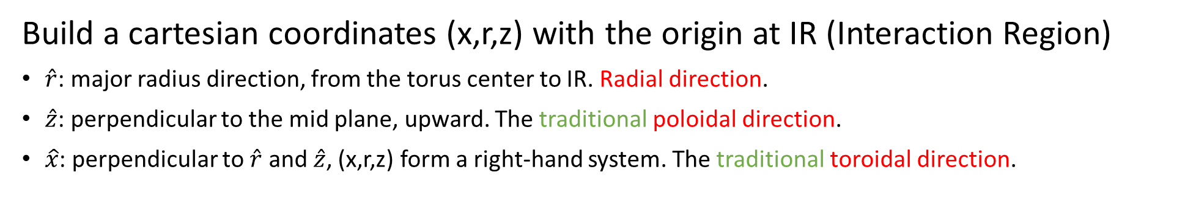

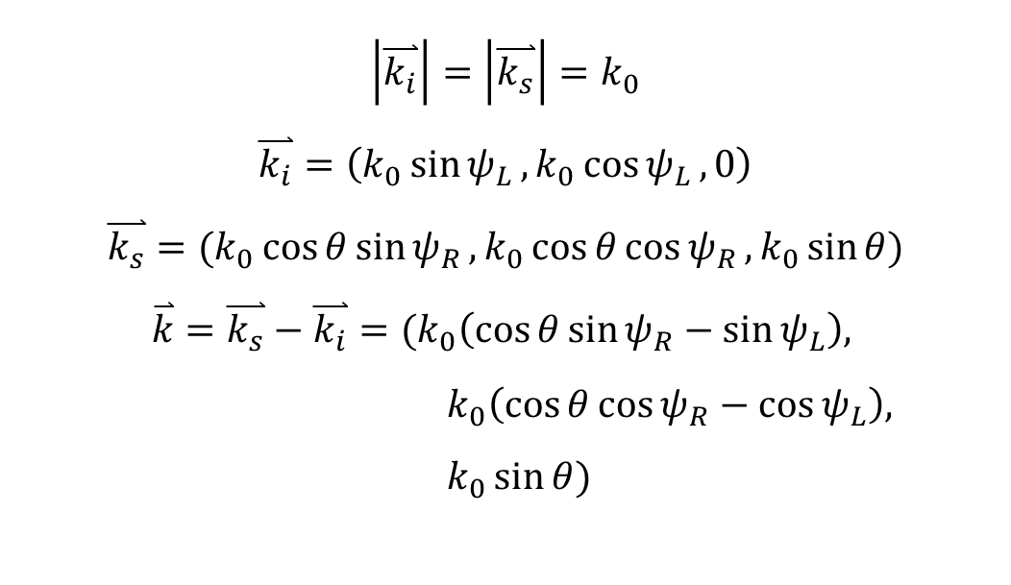




Build a cartesian coordinates (x,r,z) with the origin at IR (Interaction Region)
$\hat{r}$: major radius direction, from the torus center to IR. Radial direction.
$\hat{z}$: perpendicular to the mid plane, upward. The traditional poloidal direction.
$\hat{x}$: perpendicular to $\hat{r}$ and $\hat{z}$, (x,r,z) form a right-hand system. The traditional toroidal direction.
$$\hat{z}$$
$$\left|\overset{⃑}{k_{i}}\right|=\left|\overset{⃑}{k_{s}}\right|=k_{0}$$
$$\overset{⃑}{k_{i}}=\left(k_{0}\sin{ψ_{L}},k_{0}\cos{ψ_{L}}, 0\right)$$
$$\overset{⃑}{k_{s}}=(k_{0}\cos{θ}\sin{ψ_{R}},k_{0}\cos{θ}\cos{ψ_{R}},k_{0}\sin{θ})$$
$$\overset{⃑}{k}=\overset{⃑}{k_{s}}−\overset{⃑}{k_{i}}=(k_{0}\left(\cos{θ}\sin{ψ_{R}}−\sin{ψ_{L}}\right),$$ $k_{0}\left(\cos{θ}\cos{ψ_{R}}−\cos{ψ_{L}}\right),$ $k_{0}\sin{θ})$
$$\overset{⃑}{k_{s}}$$
IR
$$θ$$
$$ψ_{L}$$
$$\hat{r}$$
$$ψ_{R}$$
$$\hat{x}$$
$$\overset{⃑}{k_{i}}$$
radial
poloidal

Slide 23



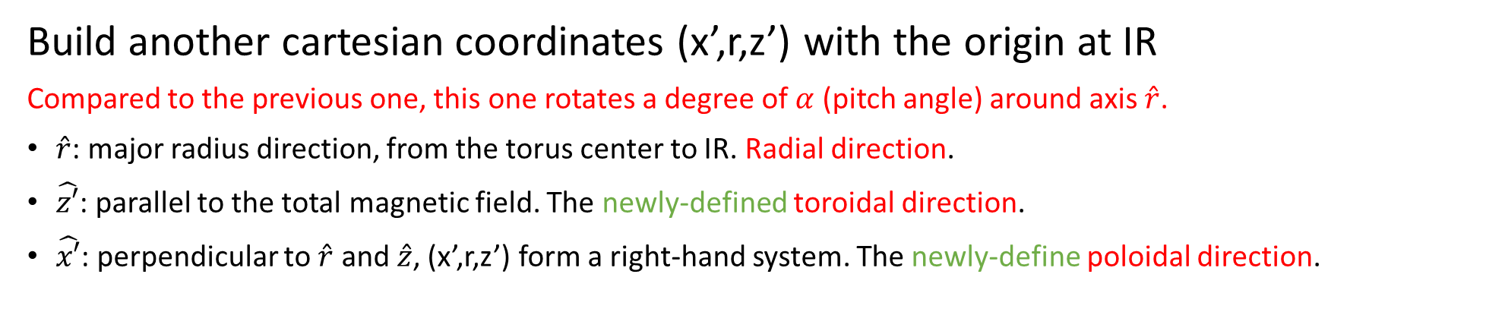



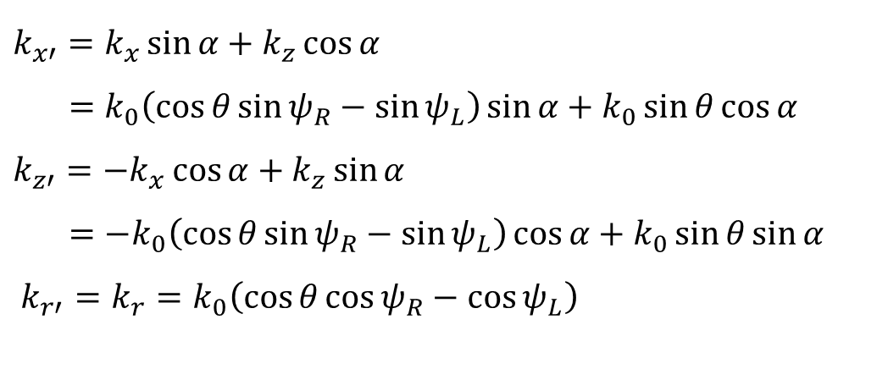
Build another cartesian coordinates (x’,r,z’) with the origin at IR
Compared to the previous one, this one rotates a degree of $α$ (pitch angle) around axis $\hat{r}$.
$\hat{r}$: major radius direction, from the torus center to IR. Radial direction.
$\hat{z′}$: parallel to the total magnetic field. The newly-defined toroidal direction.
$\hat{x′}$: perpendicular to $\hat{r}$ and $\hat{z}$, (x’,r,z’) form a right-hand system. The newly-define poloidal direction.
$k_{x′}=k_{x}\sin{α}+k_{z}\cos{α}$
$=k_{0}\left(\cos{θ}\sin{ψ_{R}}−\sin{ψ_{L}}\right)\sin{α}+k_{0}\sin{θ}\cos{α}$
$k_{z′}=−k_{x}\cos{α}+k_{z}\sin{α}$
$=−k_{0}\left(\cos{θ}\sin{ψ_{R}}−\sin{ψ_{L}}\right)\cos{α}+k_{0}\sin{θ}\sin{α}$
$k_{r′}=k_{r}=k_{0}\left(\cos{θ}\cos{ψ_{R}}−\cos{ψ_{L}}\right)$
$$\hat{x′}$$
$$\hat{z}$$
poloidal
$$\hat{z′}$$
$$α$$
radial
$$\hat{x}$$
$$\hat{r}$$

Slide 24
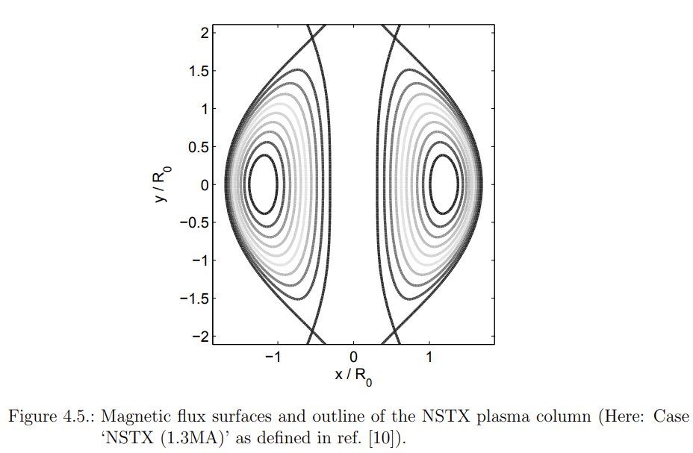
The IR (Interaction Region) is on the mid plane, we can treat that the radial direction (the connection between torus center and IR) is perpendicular to the magnetic flux surface.
But if the IR is above or below the mid plane, the radial direction is not strictly perpendicular to the magnetic flux surface, then maybe we should treat it differently if the deviation is

